Slide 1


Introduction to AI-assisted plug-in development project
时间20XX.XX
王昊扬（PM)、赵毅（FE）、刘士贤(BE)

Slide 2
CONTENTS
01
02
Introduction
Development Process
03
04
Project Evaluation
Project Summary

Slide 3
01
PART
Introduction

Slide 4
Why is the system being develop?
Develop an AI-powered language learning plugin to enhance vocabulary retention through contextual learning and smart review.
What will be done and when?
Deliverables include word tagging, AI-generated content, spaced repetition algorithm, and cross-device sync with supporting documentation. 8-week
Who is responsible for a function ?
PM handles requirements/coordination; Frontend builds UI/storage; Backend deploys AI/APIs.

Slide 5
Where are the team members ? Organizationally located ?
The team operates remotely, with the frontend developer focusing on Chrome/Figma, the backend developer deploying on AWS Lambda, and the PM coordinating via Leangoo. Members are distributed by role without a centralized office.
How will be job done technically and managerially ?
Technically: Use IndexedDB for local storage, AWS S3 for cross-device sync, and Python/Node.js for AI services. ​
Managerially: Implement bi-weekly Agile sprints, daily standups, and milestone reviews led by the PM.
How much of each resources needed ?
​Human resources: PM ,Frontend, Backend,
​Time: 8-week timeline with 1-2 buffers per milestone.
​Cost: Deepseek for AI services, free versions of Leangoofor collaboration.

Slide 6
02
PART
Development Process

Slide 7

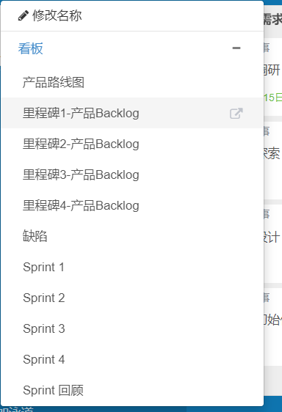
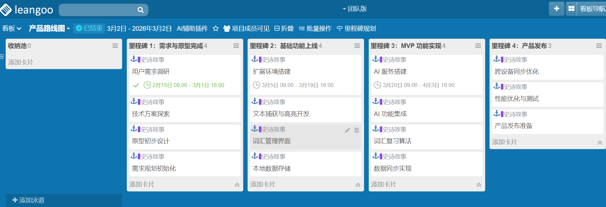
Product Roadmap

Slide 8
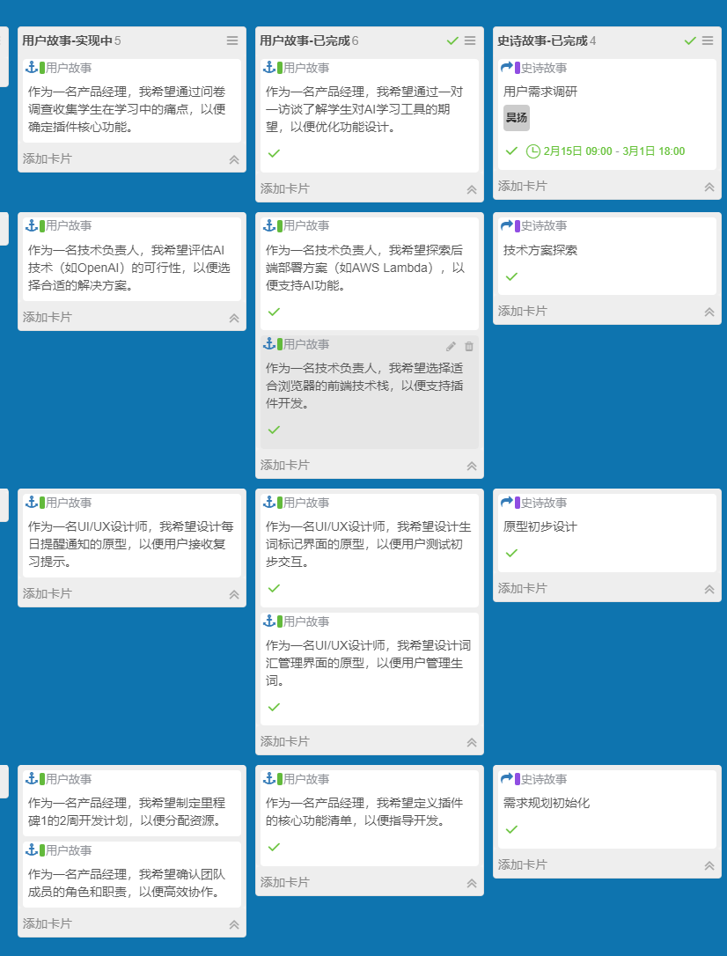
Milestone 1

Slide 9
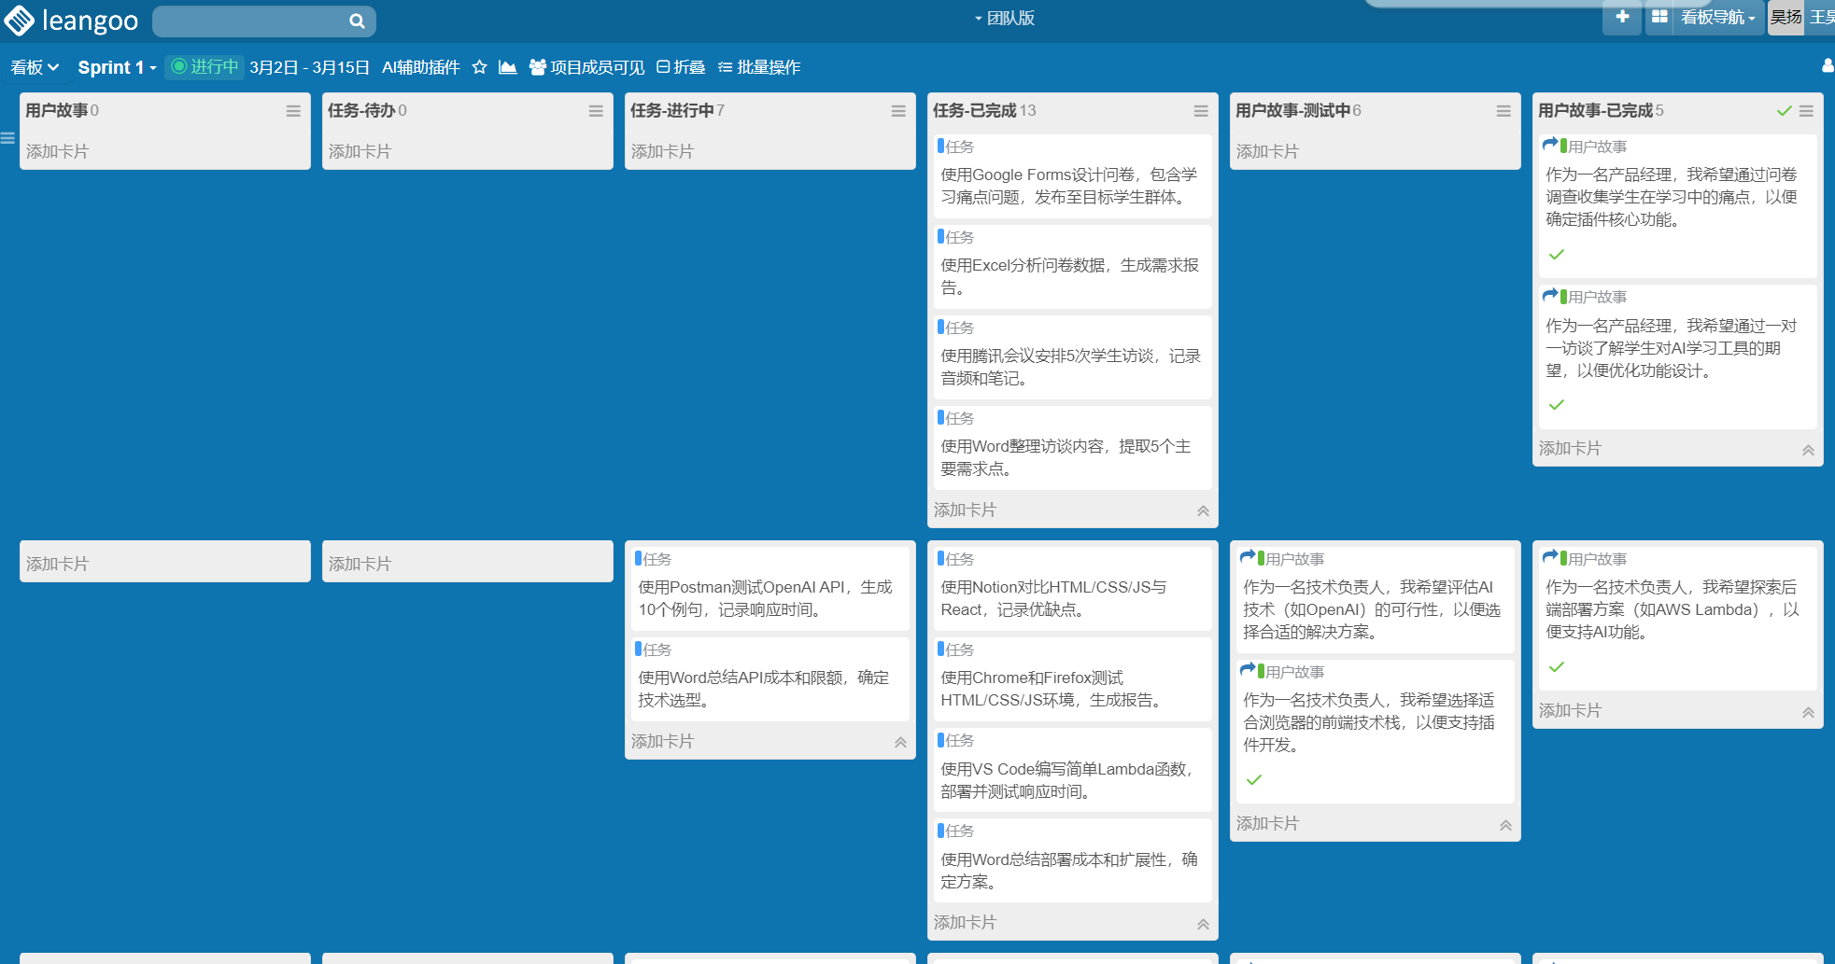
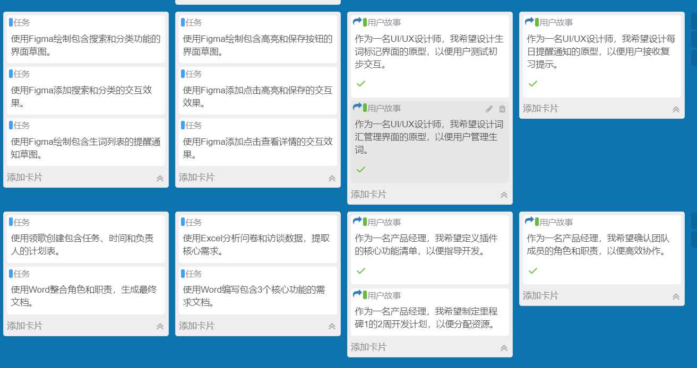
Sprint1

Slide 10

Milestone 3: MvP Functionality Implementation
Project Milestones
Time range: March 19 - April 2
Main tasks: Build AI services, integrate AI functions, and develop vocabulary review algorithms. Achieve efficient integration and call of AI services; integrate AI-generated learning questions and examples, intelligent review algorithms and other functions into plug-ins; develop intelligent review algorithms and formulate personalized review plans.
Milestone 2: Basic functions launched
Time range: March 5 - March 19
Main tasks: Develop extended function modules, advanced text context learning development, and vocabulary management interface. Improve basic functions such as new word marking and vocabulary management; develop text context learning functions to provide accurate learning content; design an intuitive and easy-to-use vocabulary management interface.
Milestone 1: Requirements and prototype completed
Milestone 4: Product Release
Time range: April 2 - April 16
Main tasks: Implement cross-device synchronization, performance optimization testing, and product release preparation. Implement the cross-device synchronization function of the plug-in; conduct comprehensive performance optimization testing to improve plug-in performance; complete various preparations before product release to ensure smooth market launch.
Time range:February 15 - March 1
Main tasks: user demand research, technical solution exploration, and preliminary prototype design. Through questionnaire surveys and user interviews, we will gain an in-depth understanding of student needs; explore AI technical solutions suitable for the project; and design a preliminary prototype of the plug-in, including interface layout and interaction process.

Slide 11
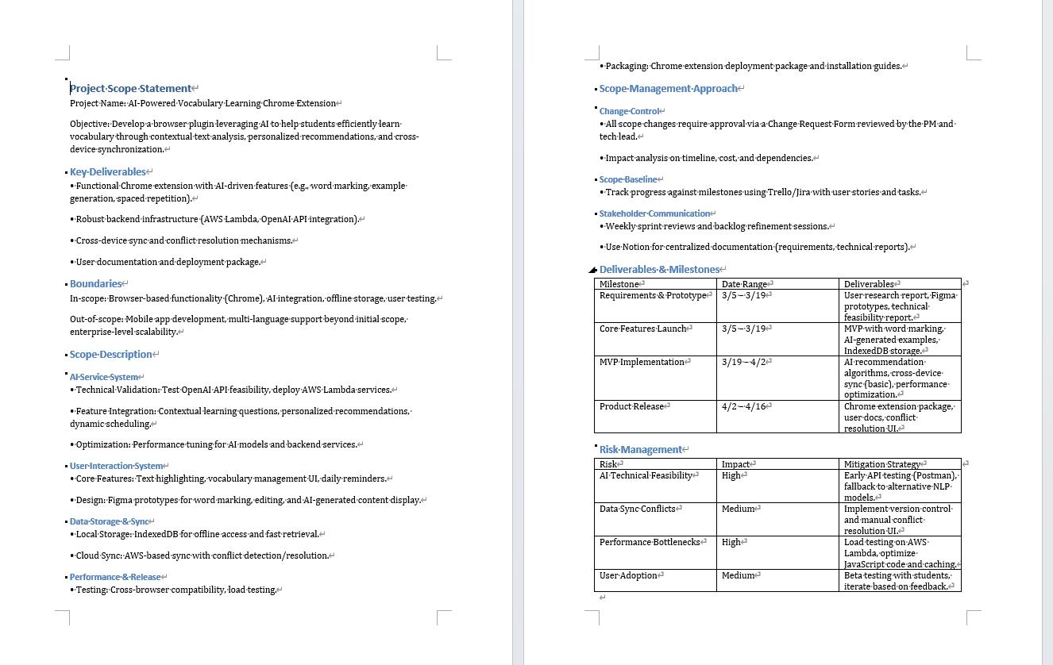
Project Management Tools
Plan Scope Management

Slide 12
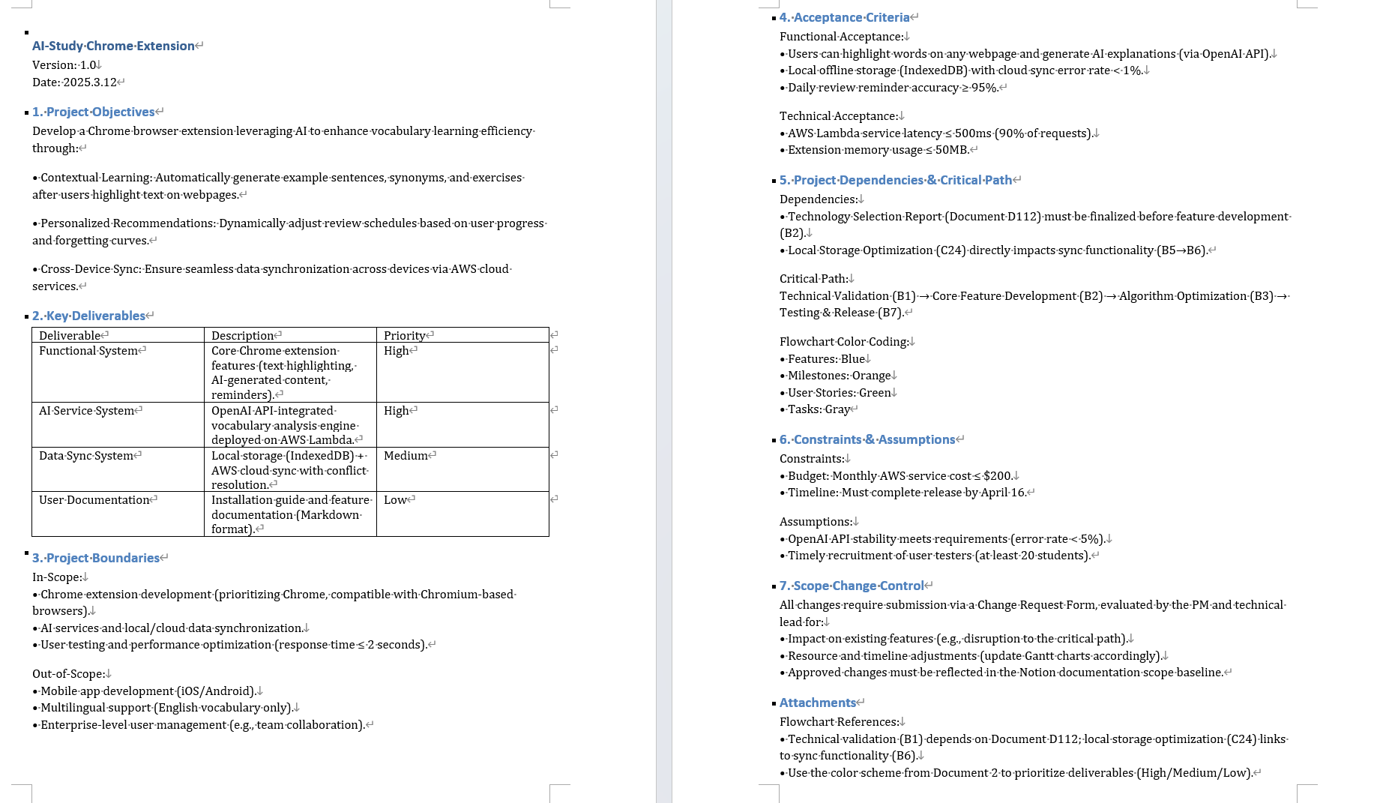
Project Management Tools
Define Scope

Slide 13
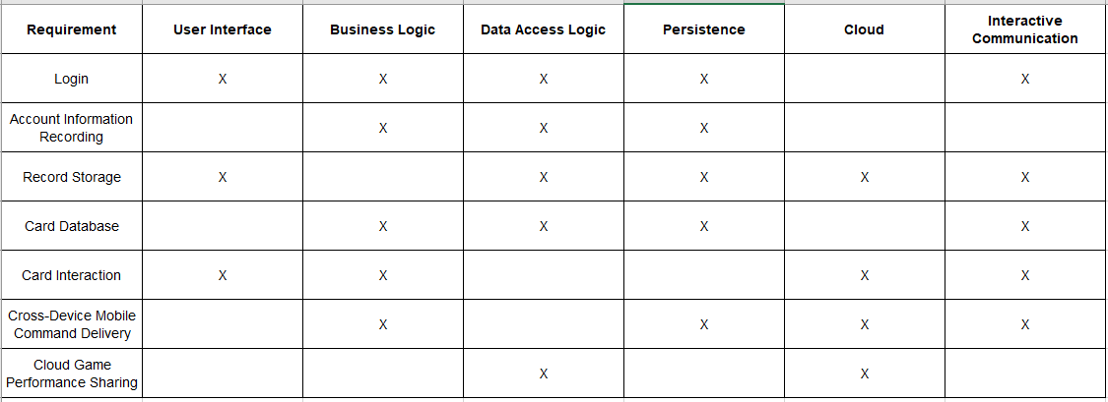
Project Management Tools
Requirement Decomposition Matrix

Slide 14
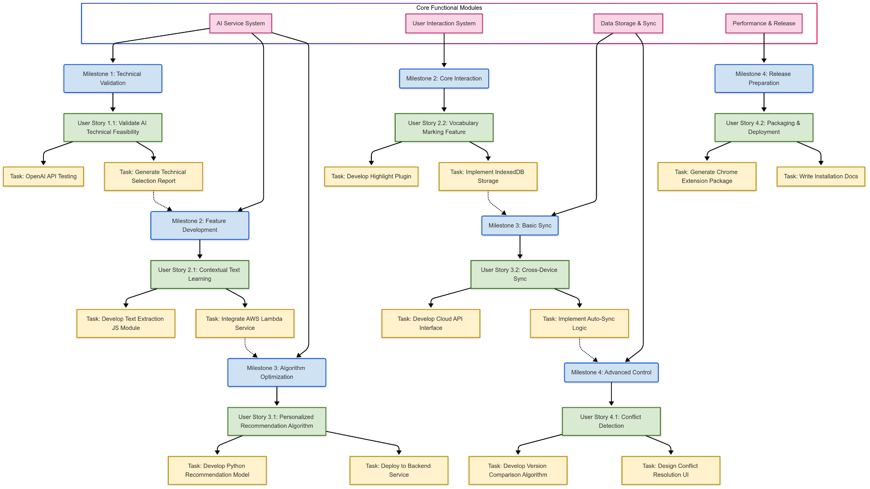
WBS Diagram
Project Management Tools

Slide 15
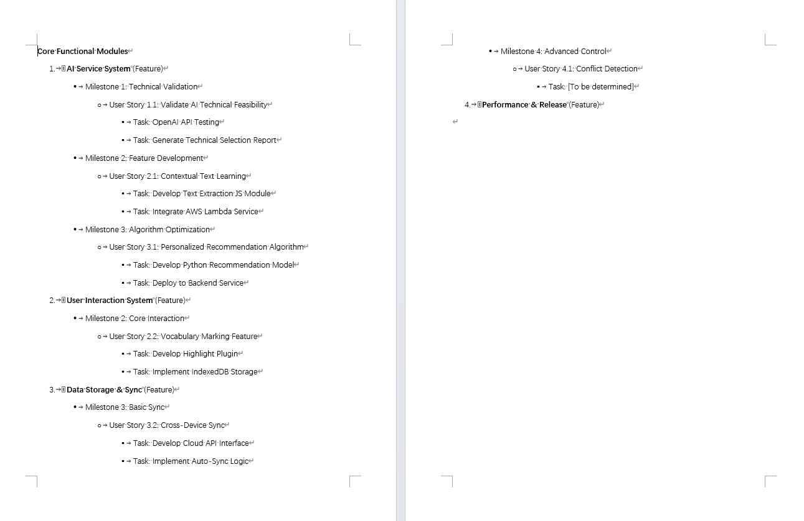
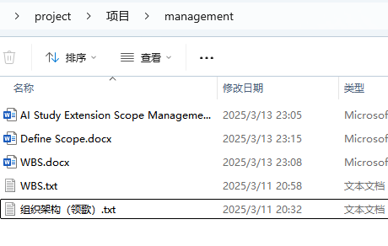
WBS
Project Management Tools

Slide 16
03
PART
Project Evaluation

Slide 17
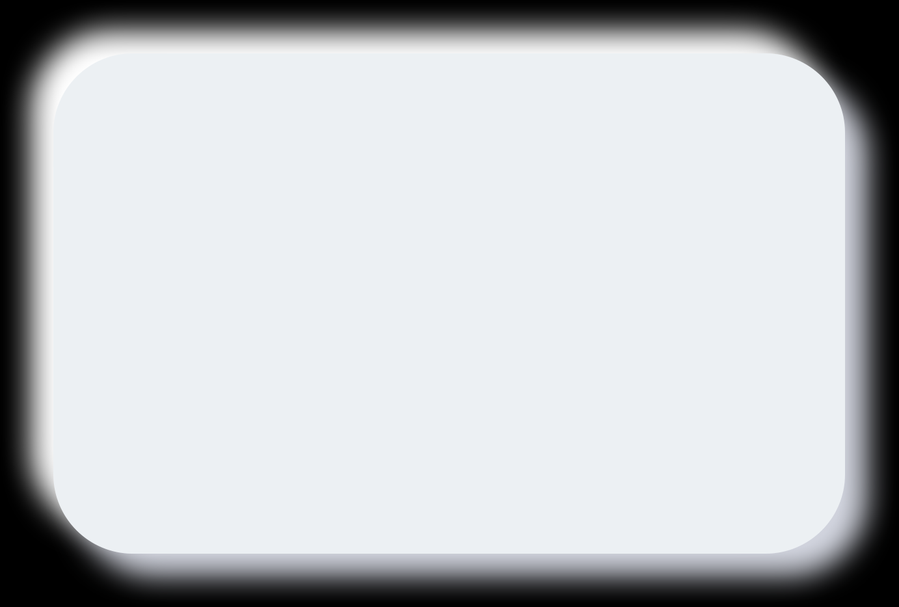
Project evaluation
PROJECT METRICS
Line of Code
LOC=4000
Defect Density
Approximately 400 bugs generated
So density = number of bugs to be generated / total lines of code=0.1
Task Completion Rate
Total tasks: 20 Completed: 8
Project completion rate = completed/total assignments=0.4

Slide 18

Process Metrics
Number of bugs before and after release
Average Defect Resoiution Time
Total hours of development
Average Code Review time
Total manpower spent on development

Slide 19


Average Code Review time
The total review time for the code was approximately 15h
Approximately 5 code reviews will be conducted.
15h/5times = 3h/times
Review
Average Defect Resolution Time
Total time for all bugs to be solved is about 80h
Number of bugs is about 400
400/80h= 5
Resolution

Slide 20
Number of bugs before and after release
Pre-release bugs
Post-release bugs
About 400 bugs
About 20 bugs

Slide 21





Total time and manpower spent
Total time
manpower spent
two months
three persons

Slide 22


Size-oriented metrics
Per KLOC bug
KLOC = 4
ERROR/BUG = 400
Per KLOC bug = 400/4 = 100
Money spent per line of code
80070/4000=20.0175
Number of documents per KLOC
Average 50 lines of code one page of documentation
Therefore, the number of document pages per KLOC is
1000/50 = 20 pages

Slide 23
Size-oriented metrics
Code bugs per person per month
Each person generates about 67 errors per month
Lines of code per person per month
Depending on the level of the team, we generate about 667 lines of code per person per month.
Money consumed per page of documentation
80070/80=1000.875

Slide 24
Function-oriented metrics
Data Function
Trading Functions
ILF
EIF
EI
EQ
EO

Slide 25
Function-oriented metrics
Data Function
Trading Functions
ILF
EI
The user enters the API key (first start authentication).
2. User input natural language requirements
1. User API Keystore
2. Error rule base
3.Card Interaction Function Library
EQ
1. Show code generation results
2. Display error detection report
EIF
1. AI Model API Interface
2. Invoke link between IDE plug-ins and error libraries
3. user history request cache
EO
1. Code generation requests are sent to the cloud model
2. Plugins and api platform synchronize data in real time

Slide 26
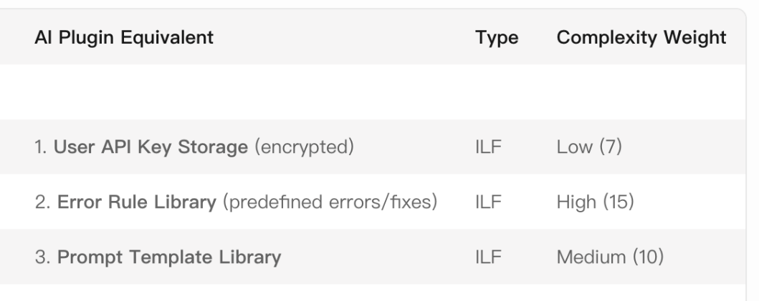
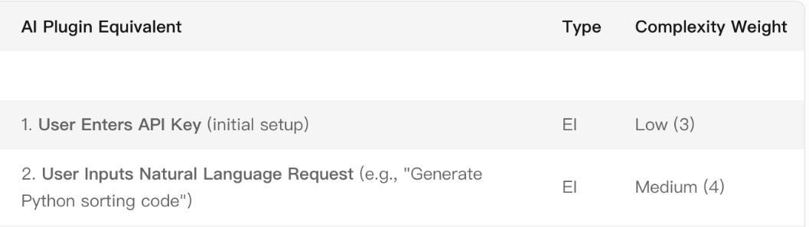
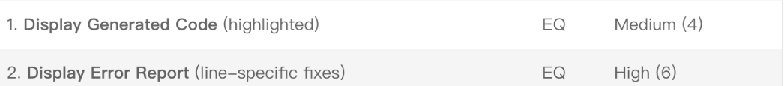
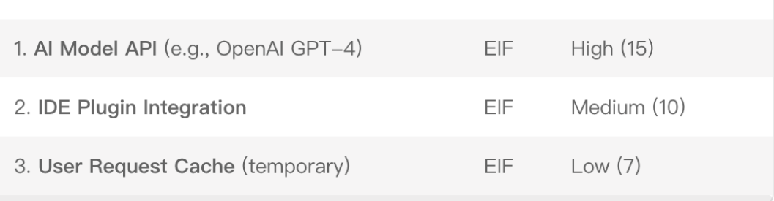
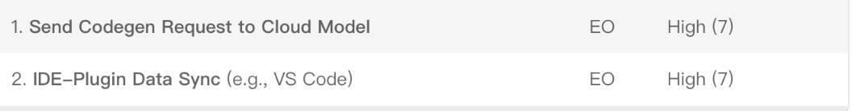
Function-oriented metrics
Data Function
Trading Functions
ILF
EI
EQ
EIF
EO

Slide 27
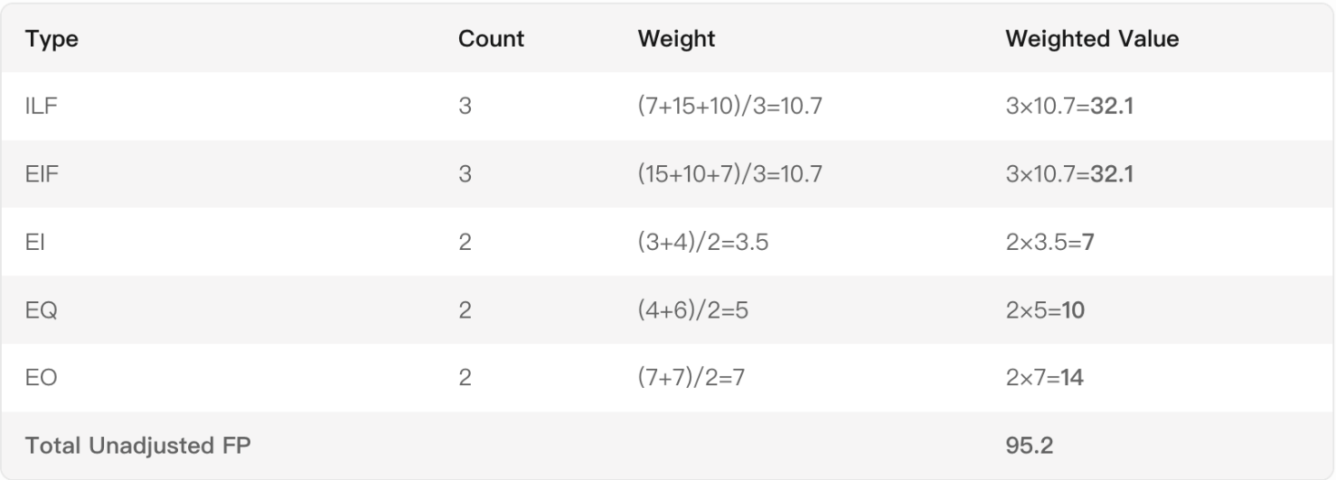

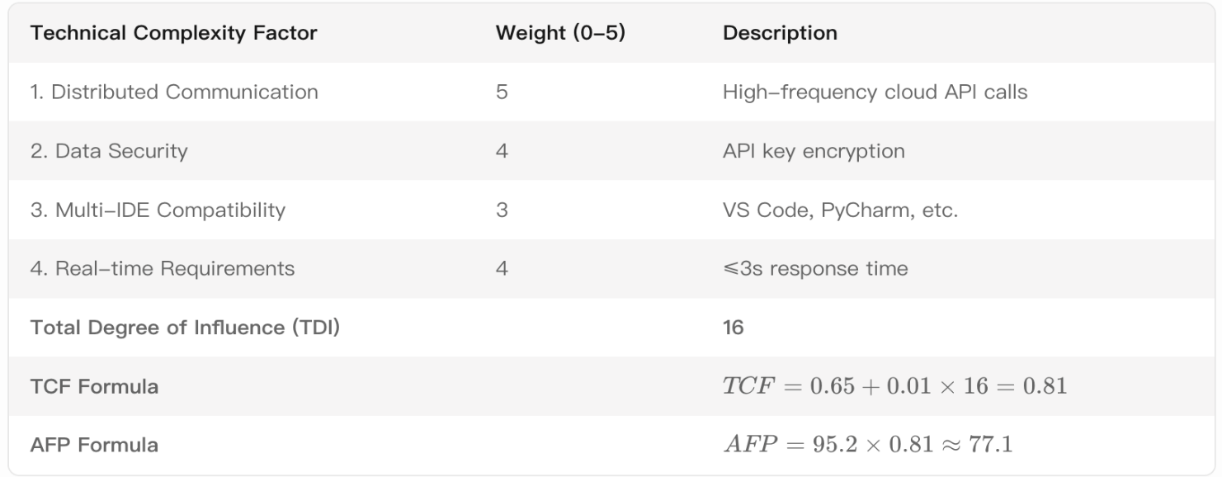
Function Point Calculation
FP
10*3+7*4+4*4+2*5+4*3
=96
AFP

Slide 28
Software Quality metrics
Error per KLOC
MTTC
Integrity
Usability
threat = 30%
security = 70%
so
integrity = 1-(0.3*(1-0.7)) = 0.91
A questionnaire was conducted to determine the complexity and ease of use of the plugin
400/4 = 100
MTTC = Σ（Time of change）/Number of changes
75h/35 = 2

Slide 29
Defect Removal Effcience
E
D
DRE
Pre-release bug
400
Bugs after release
100
D/(D+E)=4/5
DRE can also be applied to errors in activity i
DRE = ei/(ei+ei+1)

Slide 30
Software feasibility
technology
Mature technology stack and clear division of labor support project implementation
finance
time
The initial investment is about 80000, and it is expected to be profitable through the subscription model after 3-6months
Risk can be managed through buffer timing and priority adjustment

Slide 31

size of software
4000 loc
the size is about 15mb-60mb
50+ PNG
5 songs

Slide 32
Estimation model
walston - Felix model
Bailey - basili model
Boehm simple model
E= 5.2*(4)^0.9
=13.715
E=5.5+0.73*4^1.16
=9.148
E=3.2*(4)^1.05
=18.106

Slide 33
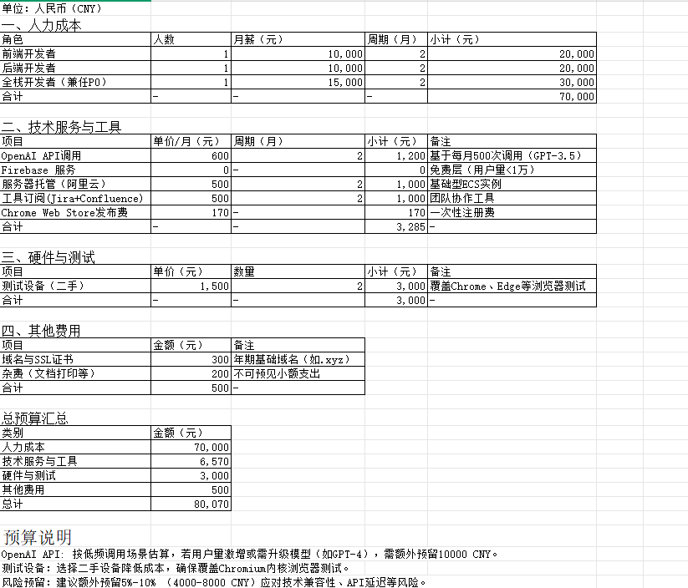
Budget

Slide 34
04
PART
Project Summary

Slide 35
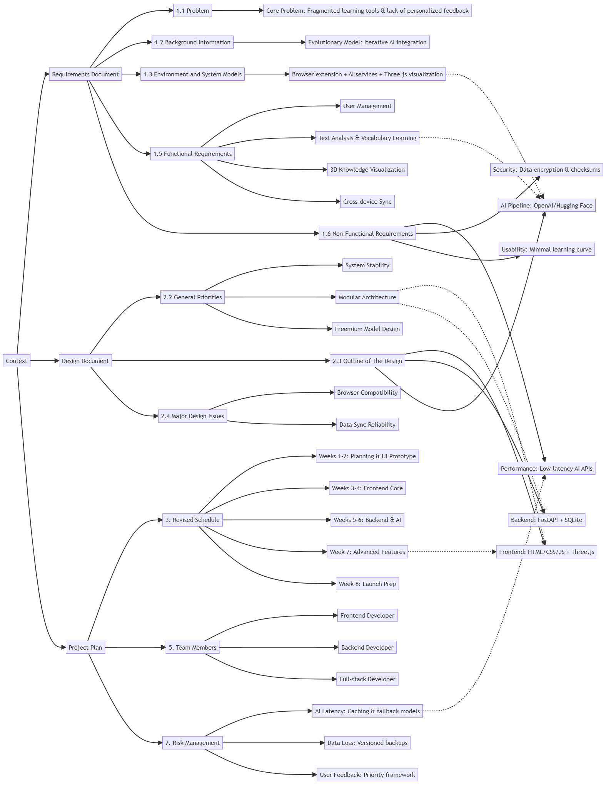
Context

Slide 36
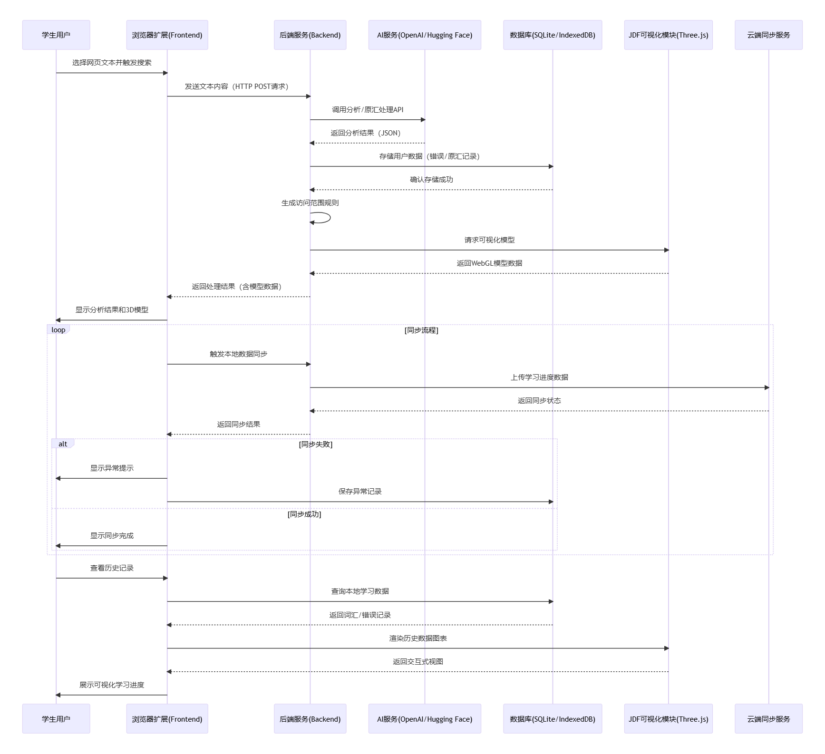
Sequence diagram
Battle for the Originium

Slide 37

DISC Traits
D+I
I+C
C+S

Slide 38
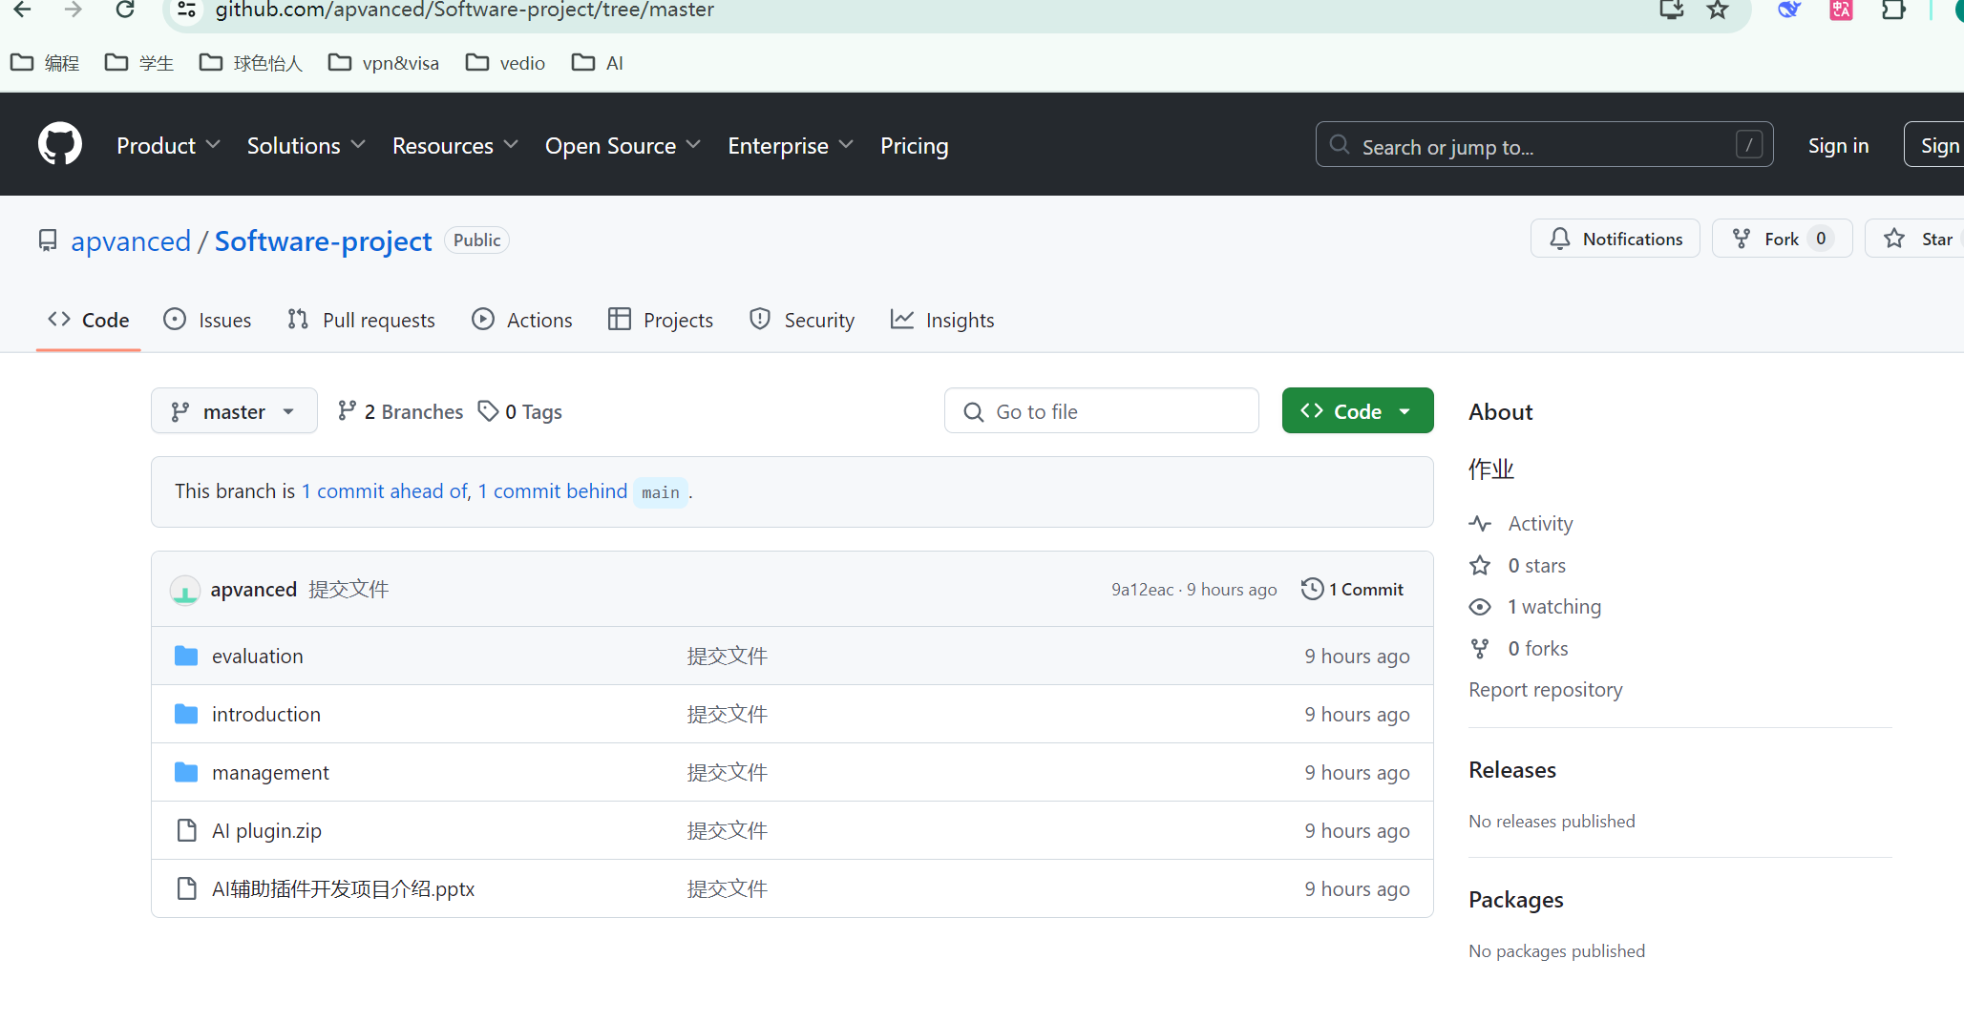
THANKS ALL
https://github.com/apvanced/Software-project/tree/master

